Slide 1
Convolutional Neural Network (CNN) for Visual Recognition
Dr Deepayan Bhowmik

Slide 2
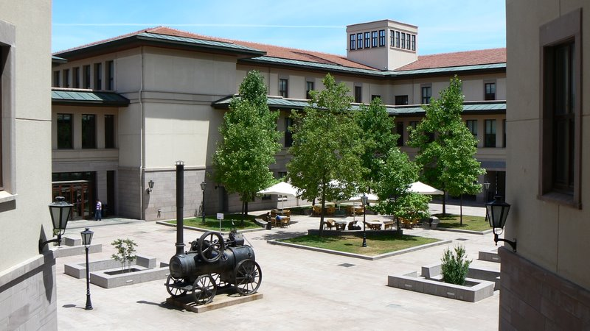
Classical Computer Vision Pipeline

Slide 3
Classical Computer Vision Pipeline.
CV experts
Select / develop features: SURF, HoG, SIFT, …
Add on top of this Machine Learning for multi-class recognition and train classifier
Feature
Extraction:
SIFT, HoG...
Detection,
Classification
Recognition
Classical CV feature definition is domain-specific and time-consuming !

Slide 4
Deep Learning –based Vision Pipeline.
Deep Learning:
Build features automatically based on training data
Combine feature extraction and classification
DL experts: define NN topology and train NN
Deep NN...
Deep NN...
Detection,
Classification
Recognition
Deep Learning promise:
train good feature automatically,
same method for different domain

Slide 5
Computer Vision +Deep Learning + Machine Learning
We want to combine Deep Learning + CV + ML
Combine pre-defined features with learned features;
Use best ML methods for multi-class recognition
CV+DL+ML experts needed to build the best-in-class
CV
features
HoG, SIFT
Deep
NN...
ML
…
Combine best of Computer Vision
Deep Learning and Machine Learning

Slide 6
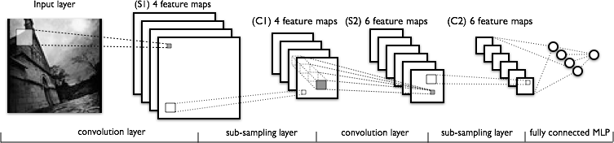
What is Convolutional Neural Network?
CNN - multi-layer NN architecture
Convolutional + Non-Linear Layer
Sub-sampling Layer
Convolutional +Non-L inear Layer
Fully connected layers
Supervised
Feature Extraction
Classi-
fication

Slide 7

What is Convolutional NN ?
2x2
Convolution + NL
Sub-sampling
Convolution + NL

Slide 8
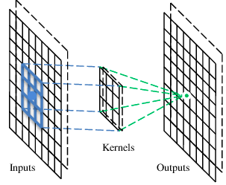
A convolutional layer
A CNN is a neural network with some convolutional layers
(and some other layers). A convolutional layer has a number
of filters that does convolutional operation.
A filter

Slide 9
Convolution
These are the network parameters to be learned.
1 | -1 | -1
-1 | 1 | -1
-1 | -1 | 1
1 | 0 | 0 | 0 | 0 | 1
0 | 1 | 0 | 0 | 1 | 0
0 | 0 | 1 | 1 | 0 | 0
1 | 0 | 0 | 0 | 1 | 0
0 | 1 | 0 | 0 | 1 | 0
0 | 0 | 1 | 0 | 1 | 0
Filter 1
-1 | 1 | -1
-1 | 1 | -1
-1 | 1 | -1
Filter 2
……
6 x 6 image
Each filter detects a small pattern (3 x 3).

Slide 10
Convolution
1 | -1 | -1
-1 | 1 | -1
-1 | -1 | 1
Filter 1
stride=1
1 | 0 | 0 | 0 | 0 | 1
0 | 1 | 0 | 0 | 1 | 0
0 | 0 | 1 | 1 | 0 | 0
1 | 0 | 0 | 0 | 1 | 0
0 | 1 | 0 | 0 | 1 | 0
0 | 0 | 1 | 0 | 1 | 0
Dot
product
3
-1
6 x 6 image

Slide 11
Convolution
1 | -1 | -1
-1 | 1 | -1
-1 | -1 | 1
Filter 1
If stride=2
1 | 0 | 0 | 0 | 0 | 1
0 | 1 | 0 | 0 | 1 | 0
0 | 0 | 1 | 1 | 0 | 0
1 | 0 | 0 | 0 | 1 | 0
0 | 1 | 0 | 0 | 1 | 0
0 | 0 | 1 | 0 | 1 | 0
3
-3
6 x 6 image

Slide 12
Convolution
1 | -1 | -1
-1 | 1 | -1
-1 | -1 | 1
Filter 1
stride=1
1 | 0 | 0 | 0 | 0 | 1
0 | 1 | 0 | 0 | 1 | 0
0 | 0 | 1 | 1 | 0 | 0
1 | 0 | 0 | 0 | 1 | 0
0 | 1 | 0 | 0 | 1 | 0
0 | 0 | 1 | 0 | 1 | 0
3
-1
-3
-1
-3
1
0
-3
-3
-3
0
1
3
-2
-2
-1
6 x 6 image

Slide 13
Convolution
-1 | 1 | -1
-1 | 1 | -1
-1 | 1 | -1
Filter 2
stride=1
Repeat this for each filter
1 | 0 | 0 | 0 | 0 | 1
0 | 1 | 0 | 0 | 1 | 0
0 | 0 | 1 | 1 | 0 | 0
1 | 0 | 0 | 0 | 1 | 0
0 | 1 | 0 | 0 | 1 | 0
0 | 0 | 1 | 0 | 1 | 0
3
-1
-3
-1
-1
-1
-1
-1
-3
1
0
-3
-1
-1
-2
1
Feature
Map
-3
-3
0
1
-1
-1
-2
1
3
-2
-2
-1
6 x 6 image
-1
0
-4
3
Two 4 x 4 images
Forming 2 x 4 x 4 matrix

Slide 14
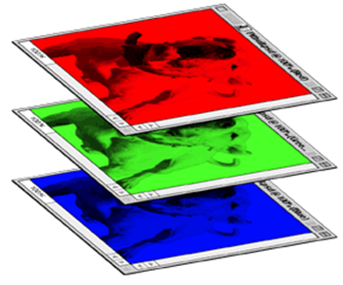
Color image: RGB 3 channels
1 | -1 | -1
-1 | 1 | -1
-1 | -1 | 1
-1 | 1 | -1
-1 | 1 | -1
-1 | 1 | -1
1 | -1 | -1
-1 | 1 | -1
-1 | -1 | 1
-1 | 1 | -1
-1 | 1 | -1
-1 | 1 | -1
1 | -1 | -1
-1 | 1 | -1
-1 | -1 | 1
-1 | 1 | -1
-1 | 1 | -1
-1 | 1 | -1
Filter 1
Filter 2
Color image
1 | 0 | 0 | 0 | 0 | 1
0 | 1 | 0 | 0 | 1 | 0
0 | 0 | 1 | 1 | 0 | 0
1 | 0 | 0 | 0 | 1 | 0
0 | 1 | 0 | 0 | 1 | 0
0 | 0 | 1 | 0 | 1 | 0
1 | 0 | 0 | 0 | 0 | 1
0 | 1 | 0 | 0 | 1 | 0
0 | 0 | 1 | 1 | 0 | 0
1 | 0 | 0 | 0 | 1 | 0
0 | 1 | 0 | 0 | 1 | 0
0 | 0 | 1 | 0 | 1 | 0
1 | 0 | 0 | 0 | 0 | 1
0 | 1 | 0 | 0 | 1 | 0
0 | 0 | 1 | 1 | 0 | 0
1 | 0 | 0 | 0 | 1 | 0
0 | 1 | 0 | 0 | 1 | 0
0 | 0 | 1 | 0 | 1 | 0

Slide 15
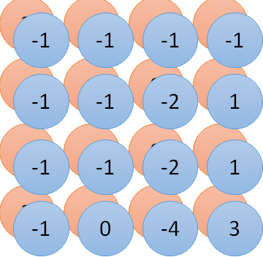
Convolution v.s. Fully Connected
1 | 0 | 0 | 0 | 0 | 1
0 | 1 | 0 | 0 | 1 | 0
0 | 0 | 1 | 1 | 0 | 0
1 | 0 | 0 | 0 | 1 | 0
0 | 1 | 0 | 0 | 1 | 0
0 | 0 | 1 | 0 | 1 | 0
1 | -1 | -1
-1 | 1 | -1
-1 | -1 | 1
-1 | 1 | -1
-1 | 1 | -1
-1 | 1 | -1
convolution
image
1 | 0 | 0 | 0 | 0 | 1
0 | 1 | 0 | 0 | 1 | 0
0 | 0 | 1 | 1 | 0 | 0
1 | 0 | 0 | 0 | 1 | 0
0 | 1 | 0 | 0 | 1 | 0
0 | 0 | 1 | 0 | 1 | 0
Fully-connected
……
……

Slide 16
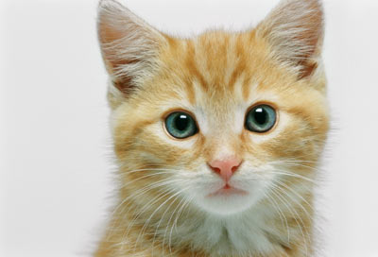
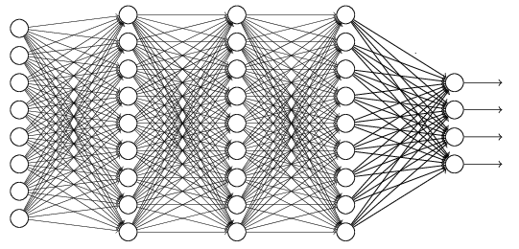
The whole CNN
cat dog ……
Convolution
Max Pooling
Can repeat many times
Fully Connected Feedforward network
Convolution
Max Pooling
Flattened

Slide 17
Max Pooling
1 | -1 | -1
-1 | 1 | -1
-1 | -1 | 1
-1 | 1 | -1
-1 | 1 | -1
-1 | 1 | -1
Filter 1
Filter 2
3
-1
-3
-1
-1
-1
-1
-1
-3
1
0
-3
-1
-1
-2
1
-3
-3
0
1
-1
-1
-2
1
3
-2
-2
-1
-1
0
-4
3

Slide 18
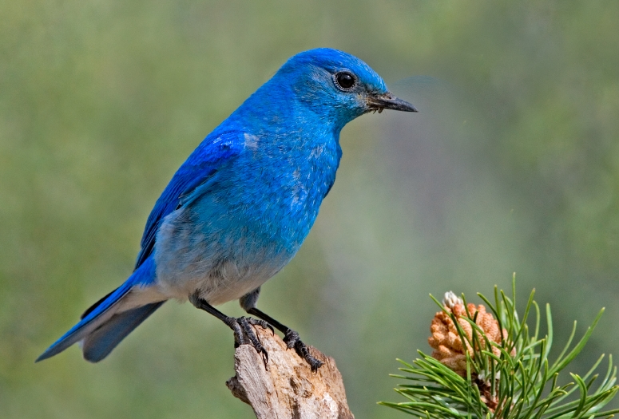

Why Pooling
Subsampling pixels will not change the object
bird
bird
Subsampling
We can subsample the pixels to make image smaller
fewer parameters to characterize the image

Slide 19
Max Pooling
New image
but smaller
1 | 0 | 0 | 0 | 0 | 1
0 | 1 | 0 | 0 | 1 | 0
0 | 0 | 1 | 1 | 0 | 0
1 | 0 | 0 | 0 | 1 | 0
0 | 1 | 0 | 0 | 1 | 0
0 | 0 | 1 | 0 | 1 | 0
Conv
3
0
-1
1
Max
Pooling
3
1
0
3
2 x 2 image
6 x 6 image
Each filter
is a channel

Slide 20
The whole CNN
3
0
-1
1
Convolution
3
1
0
3
Max Pooling
Can repeat many times
A new image
Convolution
Smaller than the original image
The number of channels is the number of filters
Max Pooling

Slide 21
The whole CNN
cat dog ……
Convolution
Max Pooling
Fully Connected Feedforward network
A new image
Convolution
Max Pooling
Flattened
A new image

Slide 22
Flattening
3
0
1
3
0
-1
1
3
3
1
-1
0
3
Flattened
1
Fully Connected Feedforward network
0
3

Slide 23


CNN in Keras
Only modified the network structure and input format (vector -> 3-D tensor)
input
Convolution
1 | -1 | -1
-1 | 1 | -1
-1 | -1 | 1
-1 | 1 | -1
-1 | 1 | -1
-1 | 1 | -1
There are 25 3x3 filters.
……
Max Pooling
Input_shape = ( 28 , 28 , 1)
28 x 28 pixels
1: black/white, 3: RGB
Convolution
3
-1
3
Max Pooling
-3
1

Slide 24
CNN in Keras
Only modified the network structure and input format (vector -> 3-D array)
Input
1 x 28 x 28
Convolution
25 x 26 x 26
Max Pooling
25 x 13 x 13
Convolution
50 x 11 x 11
Max Pooling
50 x 5 x 5

Slide 25
CNN in Keras
Only modified the network structure and input format (vector -> 3-D array)
Input
1 x 28 x 28
Output
Convolution
25 x 26 x 26
Fully connected feedforward network
Max Pooling
25 x 13 x 13
Convolution
50 x 11 x 11
Max Pooling
1250
50 x 5 x 5
Flattened

Slide 26
Conv Nets: beyond Visual Classification

Slide 27

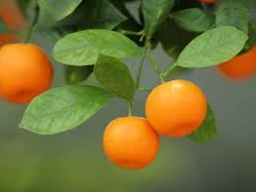
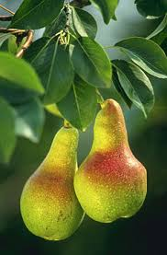
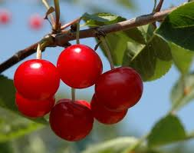
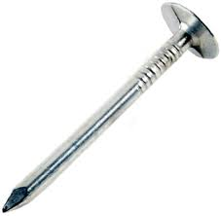
CNN applications
CNN is a big hammer
Plenty low hanging fruits
You need just a right nail!

Slide 28
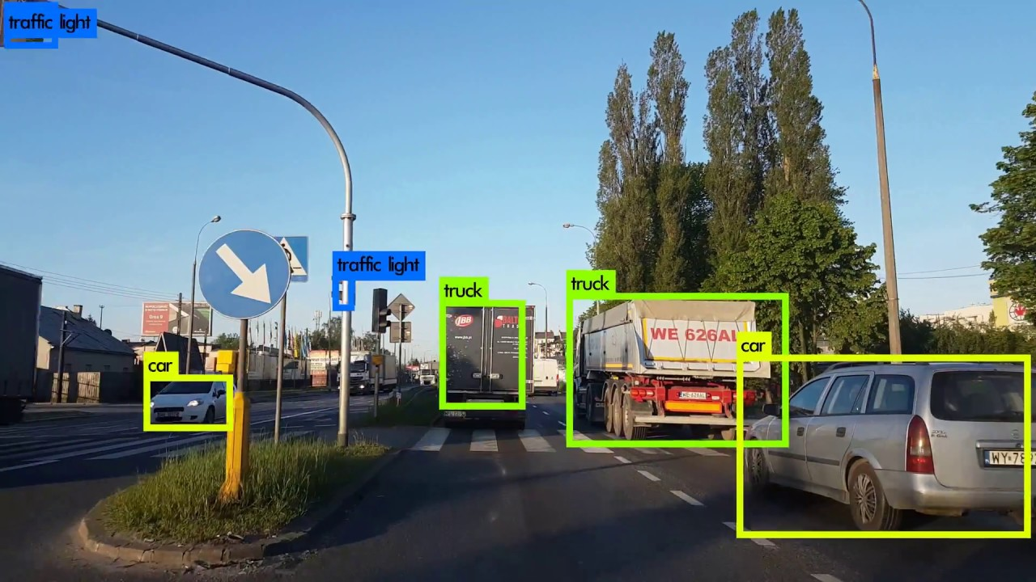
Conv NN: Detection

Slide 29
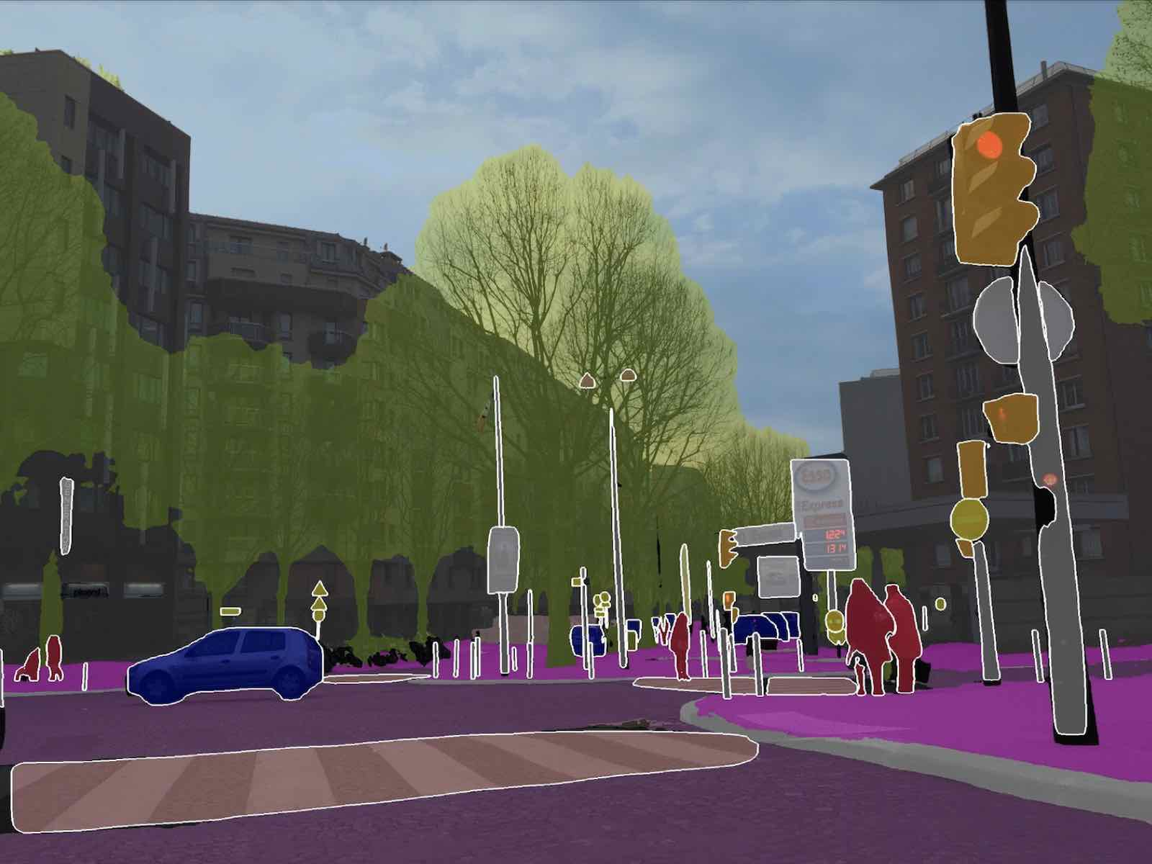
Conv NN: Scene parsing

Slide 30
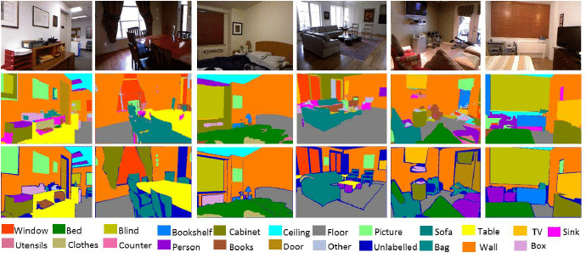
CNN: indoor semantic labeling

Slide 31
Conclusions
We have covered the fundamental understanding of convolutional neural network.
A lab will follow this week to implement a basic CNN

